Slide 1




NEXT GEN EMPLOYABILITY PROGRAM
Creating a future-ready workforce
Team Members
College Name
Student Name :POOVARASAN M
Student ID : 511321205023
KINGSTON ENGINEERING COLLEGE

Slide 2

CAPSTONE PROJECT SHOWCASE
Project Title
Building Bus Reservation System using Python and Django
Abstract | Problem Statement | Project Overview | Proposed Solution | Technology Used | Modelling & Results | Conclusion

Slide 3
Abstract
Efficient travel is crucial in today's world, especially in bus transportation. This abstract introduces a user-friendly Bus Reservation System (BRS) that simplifies booking, enhances passenger experience, and boosts operational efficiency.
The BRS is an integrated platform accessible through web and mobile apps. It offers real-time seat availability, route management, and secure payment options for seamless booking.
Key features include user registration, dynamic route management, seat selection, secure payments, real-time tracking, and reporting tools.
By using modern technology like cloud computing and GPS tracking, the BRS improves bus travel for passengers and operators alike. It's a step forward in convenience and reliability for the transportation industry.
Source :

Slide 4
Problem Statement
Booking buses today is often frustrating due to outdated systems. The current reservation setups are complicated, not easy to use, and lack real-time updates.
Passengers struggle to find available seats, especially when using different devices. They also face uncertainties about routes, delays, and payment security.
To enhance bus booking experiences, we need a modern Bus Reservation System (BRS) that's user-friendly, accessible, and provides real-time information.
This system should help passengers book easily, stay informed about their journey, and ensure their security. Additionally, it should assist bus operators in managing resources efficiently and adapting to changing demand.
Source :

Slide 5
Project Overview
The project involves creating a user-friendly web platform using Python Django for booking bus tickets. It will offer passengers the ability to search for buses, view schedules, select seats, and make reservations online.
Administrators will have tools to manage routes, schedules, fares, and user accounts. Security measures will be implemented, including encryption for sensitive data.
The system will be responsive across devices and integrate with payment gateways for secure transactions. Testing, documentation, and deployment will ensure reliability and usability.
Overall, the project aims to simplify bus ticket booking for passengers and improve operational efficiency for bus operators.
Source :

Slide 6
Proposed Solution
.
The proposed solution involves developing a web-based bus reservation system using Python Django framework to address the identified challenges and provide a seamless booking experience for passengers. Here's an outline of the proposed solution:
1.User-Friendly Interface:
- Design a user-friendly interface accessible via web browsers for passengers to easily search for buses, view schedules, select seats, and make reservations.
2.Administrator Dashboard:
- Create a comprehensive dashboard for administrators to manage bus routes, schedules, fares, and user accounts efficiently.
3.Database Management:
- Utilize Django's ORM for effective database management, storing information such as bus routes, schedules, available seats, fares, and user details securely.
Source :

Slide 7
4.Authentication and Security:
Implement Django's authentication system to secure user accounts and transactions.
Employ encryption techniques to safeguard sensitive data like payment information.
5.Responsive Design:
Develop a responsive design ensuring the platform's compatibility across various devices, including desktops, laptops, tablets, and smartphones.
6.Integration with Payment Gateways:
Integrate with popular payment gateways to enable secure online transactions, allowing passengers to make payments using credit/debit cards or digital wallets.
Source :

Slide 8
7.Testing and Quality Assurance:
Conduct rigorous testing to identify and resolve any bugs or issues.
Implement quality assurance measures to ensure the system's reliability, performance, and usability.
8.Documentation and Deployment:
Provide comprehensive documentation for developers, administrators, and end-users to understand and utilize the system effectively.
Deploy the system on a reliable web hosting platform to ensure accessibility and availabilit
Source :

Slide 9


Technology Used
Front-end
Back-end
Source :

Slide 10
Modelling & Results
Modeling:
Database Schema: Design a database schema to store information such as bus routes, schedules, available seats, fares, user accounts, and reservations. Utilize Django's ORM to define models and relationships between them.
User Interface Mockups: Create mockups or wireframes to visualize the user interface design, including pages for searching buses, viewing schedules, selecting seats, making reservations, and managing bookings.
System Architecture: Define the system architecture, including components such as frontend, backend, authentication system, payment gateway integration, and database management.
Source :

Slide 11
2. Results:
Database Implementation: Implement the database schema using Django models and migrate data.
User Interface Development: Develop the user interface based on the mockups, ensuring a seamless and intuitive booking experience for passengers.
Functionality Implementation: Implement core functionalities such as bus search, schedule viewing, seat selection, reservation creation, and booking management.
Authentication and Security: Integrate Django's authentication system for user authentication and implement security measures to protect user data and transactions.
Payment Gateway Integration: Integrate with payment gateways to facilitate secure online transactions.
Testing and Quality Assurance: Conduct thorough testing to ensure the system functions as expected, identifying and fixing any bugs or issues.
Documentation: Prepare comprehensive documentation for developers, administrators, and end-users, including user guides and technical specifications.
Deployment: Deploy the system on a reliable hosting platform, ensuring availability and scalability.

Slide 12
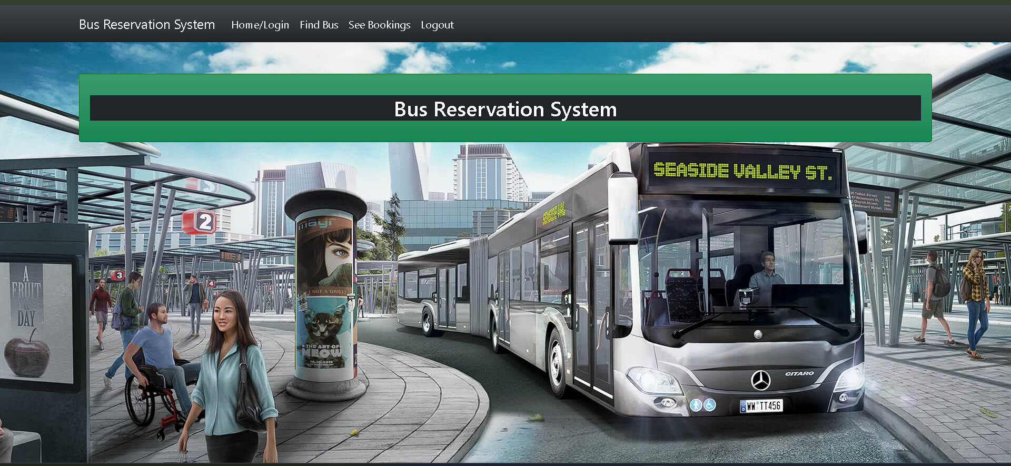
Homepage

Slide 13
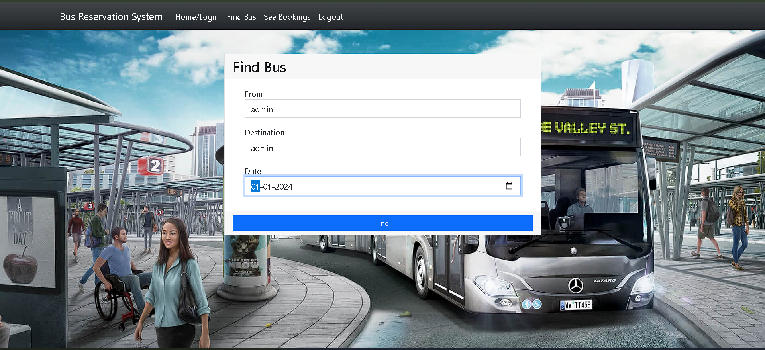
About-Us-Page

Slide 14
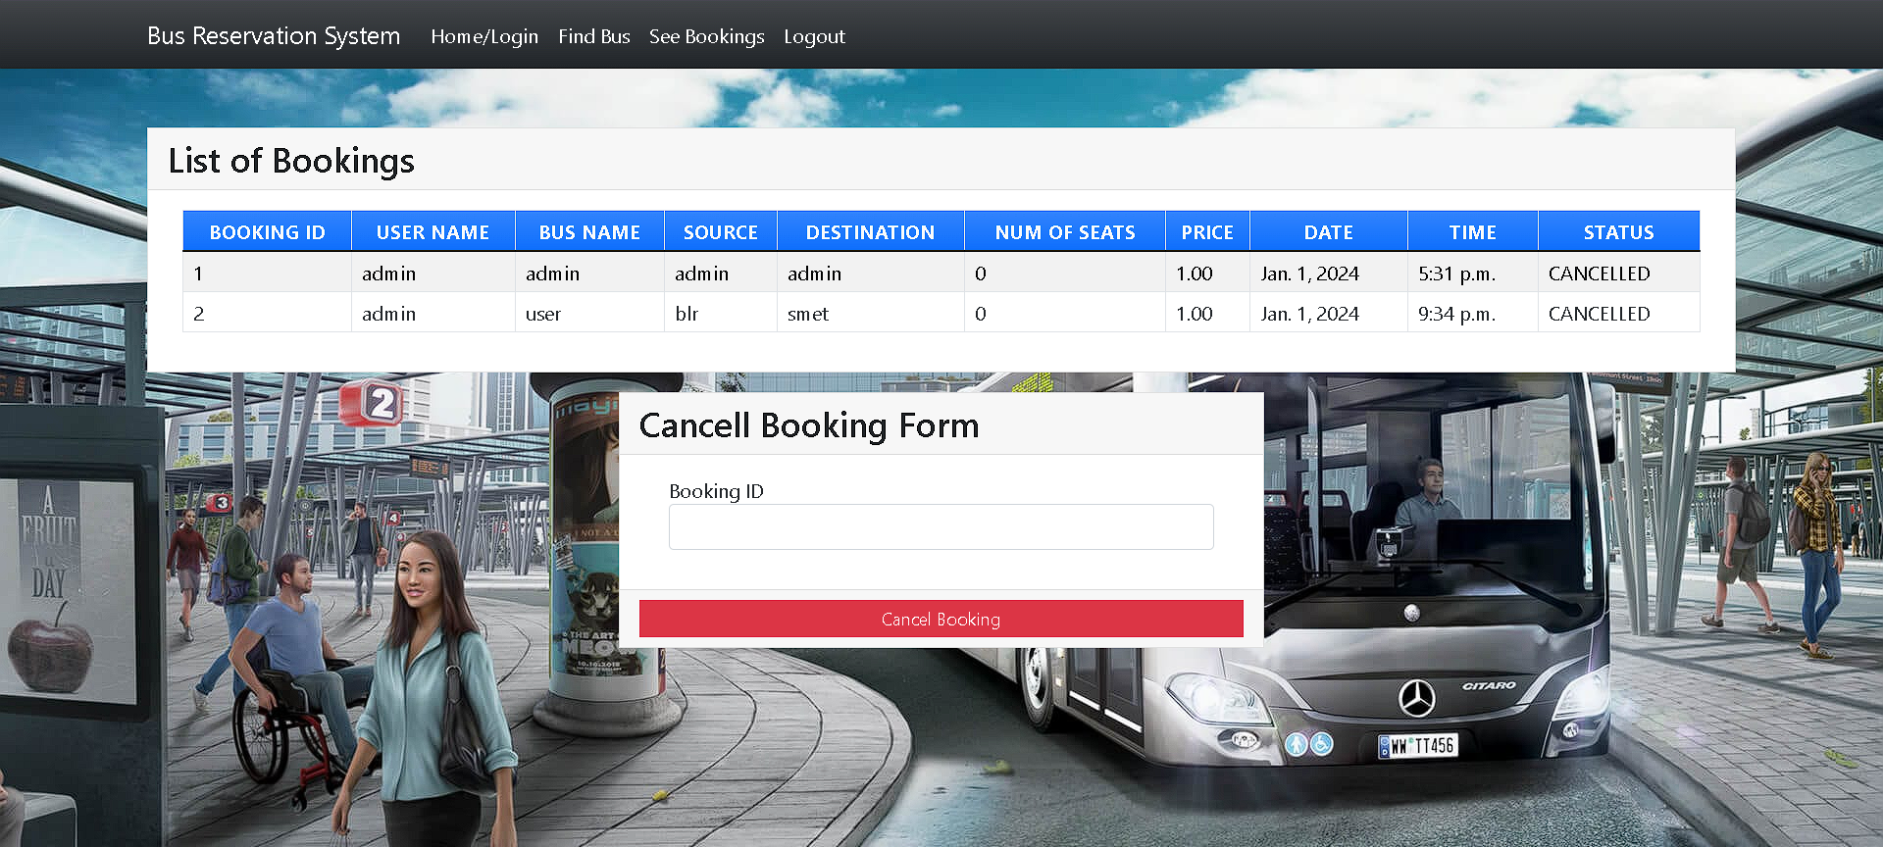
Service-Page

Slide 15
Departments-Page

Slide 16
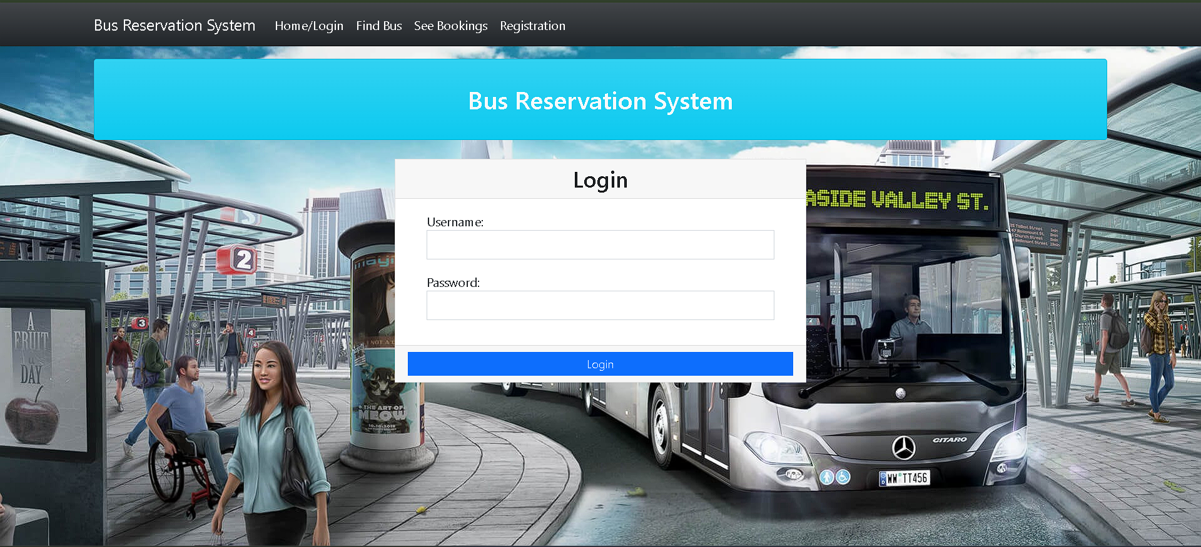
Blog-Page

Slide 17
Future Enhancements:
1.Mobile App Development: Create a mobile app for booking tickets on smartphones, offering convenience and accessibility.
2.Dynamic Pricing and Offers: Implement dynamic pricing and promotional offers to attract more customers and optimize revenue.
3.Transit API Integration: Integrate with transit APIs to offer multi-modal travel solutions and enhance connectivity.
4.Seat Selection Customization: Allow passengers to customize seat preferences for a more personalized booking experience.

Slide 18
5.Real-Time Bus Tracking: Provide real-time bus tracking for passengers to monitor bus locations and arrival times.
6.Feedback and Rating System: Introduce a feedback system for passengers to rate their experience and improve service quality.
7.Accessibility Features: Enhance accessibility options to accommodate passengers with disabilities.
8.Predictive Analytics: Use predictive analytics to forecast demand and optimize bus scheduling.
9.Environmental Sustainability Initiatives: Implement eco-friendly initiatives to promote environmental sustainability.
10.Integration with Travel Partners: Collaborate with travel partners to offer integrated travel packages and enhance the overall customer experience.

Slide 19
Conclusion
In summary, the web-based bus reservation system developed using Python Django offers a convenient and efficient solution for passengers to book tickets and for bus operators to manage their services.
With user-friendly interfaces, secure transactions, and advanced features, it enhances the overall travel experience.
Future enhancements like mobile app integration and dynamic pricing further improve its functionality, making it a valuable asset in modernizing the transportation industry.
Source :

Slide 20
Thank You!
Notes:
Thank You !!

